Slide 1
WorkshopPLUS - Windows Server: Vital Signs Part 1
Notes:
Version: 12/21/2018 18:22:55

Slide 2
Disclaimer

Slide 3
Storage

Slide 4
Learning Units covered in this Module
Physical Disk Hardware Virtual Storage Introducing Disk Performance counters & Concepts

Slide 5
Physical Disk Hardware

Slide 6
Learnings covered in this Unit
Hard disk media built into servers
IOPS
IOPS in detail
What is Latency?
Storage Stack

Slide 7
Hard disk media built into servers

Slide 8
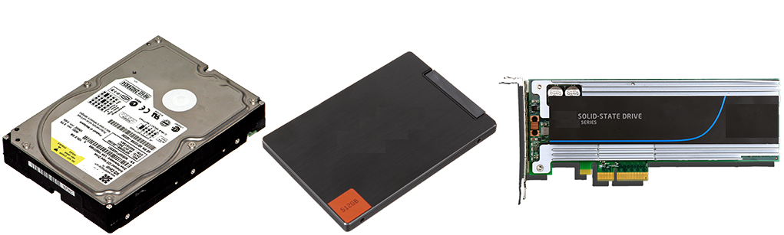
Physical Hard Disk Media built into servers
HDDs
SSD
NvmE-SSD
Raids
Drive | Read/write per Second (4kB Block R/W) | Max Sequential Read / Write throughput
HDD (up to 15k rpm) | Up to 420 Read/writes / sec | ~ 200 MB/Sec
SATA SSD | 99,000 Read 18,000 Write | 520 MB/Sec Read 475 MB/Sec Write
NVMe SSD | 430,000 Read 50,000 Write | 3500 MB/Sec Read 2100 MB/sec write
Notes:
Hard disk drives (magnetic media) have not changed in many years and are still widely in use today. About 5 years ago, 2.5” enterprise scale hard drives that can spin at 10,000 and 15,000 RPM were introduced.
Going to 2.5” from 3.5” drives reduced track-to-track latency down to 2-3 ms by having a smaller drive head armature to move and smaller spaces between the tracks. However, this is the effective limit of hard drive media for the near future. http://wikipedia.org/wiki/Hard_disk_drive

Slide 9
IOPS

Slide 10
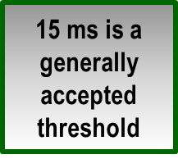
Input/output Operation Per Second
IOPS is an industry measurement of the hardware throughput of read/writes per second of a disk or a collection of disks
For example, a single 7200 RPM disk drive has an access time of 13 ms, which calculates to at least 77 IOPS. However, will usually yield about 120 average IOPS nominally due to cache
Average response time longer than 15 ms is generally considered slow
The following chart shows typical IOPS times
*Based on Wikipedia
**Not all SSD drives are created equally. IOPS can vary from 5k to 85k.
Storage | IOPS* | IOPS cached | Access time (ms)
3.5“ floppy disk USB drive | 10 | 20 | 600
5400 RPM hard disk | 15-50 | 30-100 | 17
10K RPM hard disk | 75-100 | 150-200 | 11
15K RPM hard disk | 175-210 | 350-420 | 6
Solid state drive (SSD) | 5k-85k** | Expensive | 0.2*
NVMe | 750k | Expensive | 0.006*
Notes:
IOPS is an industry standard for measuring the hardware throughput of a disk subsystem.
You can calculate the IOPS of your disk hardware, if you read its specifications and determine what its access time is
All of the metrics mentioned in the previous slide can be compared to performance counters
The chart on this slide shows the worst-case (no cache; full stroke) access times for common hard drives
Hardware specifications and performance vary greatly between manufacturers
For NVMe-Storage:
https://www.cs.utah.edu/~manua/pubs/systor15.pdf
https://en.wikipedia.org/wiki/IOPS
For more information on this subject, see: http://wikipedia.org/wiki/IOPS

Slide 11
IOPS in detail

Slide 12

IO Operation in detail
An IO request is a datastream of a specific size which needs to be written to disk
Access-Pattern can be random or sequential
Size of an IO-Request is important due to blocksize
Blocksize of the volume defines the „container“ where the IO Request is written/read
Throughput of a disk =
Number of IO Operation/Sec *
SizeOfIO
Notes:
Detailed Testing of several different Harddisk in combination with different block sizes:
https://sp.ts.fujitsu.com/dmsp/Publications/public/wp-single-disk-performance-ww-de.pdf
Real Life Example:
Fright-Container-Crane loading a ship with containers.
Link to the picture:
http://www.intuitiveaccountant.com/general-ledger/eliminate-disk-io-bottlenecks-for-quickbooks-performance/#.WjvqlExFyUk

Slide 13

Fragmentation
Fragmentation is the result of constant data movement on the file system, also called aging of the file system
https://en.wikipedia.org/wiki/File_system_fragmentation
Causes increased head movement which increases latency
Defragmentation moves data
blocks to reduce head
movement
Notes:
Credit goes to XZise - Own work, CC BY-SA 3.0, https://commons.wikimedia.org/w/index.php?curid=4128212 for the GIF

Slide 14
Challenge Question
If your application requires 2000 IOPS, how many disks are needed (not accounting for RAID overhead)?
Answer: It depends on the disk speed. You might need 5 15k RPM disks with cache or you may need 8 10k RPM disks with cache or you may only need 1 SSD
Required IOPS/IOPS per disk = Amount of disks needed
2000 (IOPS needed)/400 (1 15k disk with cache) = 5
2000 (IOPS needed)/250 (1 10k disk with cache) = 8
2000 (IOPS needed)/5000 (1 SSD) = 1
Notes:
The amount of disks needed to perform 2000 IOPS depends on the type of disk used. Faster disks allow for more IOPS. If fast 15k disks are used, there would need to be at least 5 disks to cover 2000 IOPS.
Each 15k disk should be capable of 350-420 IOPS. Ensure that the Average Seek Time on the disks is at least 3 ms. If the Average Seek Time is slower, you would need more disks.

Slide 16
What is Latency?

Slide 17
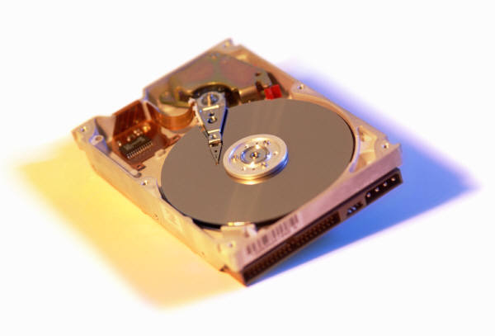
What is Latency in a physical disk in detail?
A 15,000 RPM drive rotates once every 4 milliseconds:
1/ (15000/60) or .004 Seconds = 4 ms
If we observe 40 ms of constant disk read latency, that means that a 15k rpm hard drive has already had time to read the same blocks (up to 64kb) of data up to 10 times successfully, so why is there latency?
Notes:
What Does Microsoft Consider Disk Latency?
The time it takes a read or write to pass through the disk performance filter and return as completed. There are a number of factors, which can speed up or slow down latency. This example simply help explains the magnitude of the numbers.

Slide 18
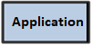
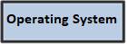
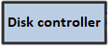
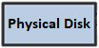

What is Latency for the application?
Latency is the time passed of an IO-Request send to the disk and the confirmation is received
Each station of this way is consuming time and the sum of the entire way is the latency observed by the operating system / application
Bottlenecks are logical constructs used to describe latency
BlockSize
FilterDriver
CPU
Memory
Hardware Driver
Cache
Other drives
Cable
PCI
Hardware
Controller
Cache
Hardware
Notes:
What this slide is trying to communicate is that there are multiple levels and devices typically involved in getting data to and from a storage device. In its simplest form there is the hard drive latency itself, and the disk controller which must process the Redundant Array of Independent Disks (RAID) overhead when there are multiple hard drives involved.
In remote storage scenarios, such as a Network Attached Storage (NAS) or a Storage Area Network (SAN):
The number of intermediate devices increases to include a Host Bus Adapter (HBA)-controller in the server, fiber optic switches
The communication ports in the storage device called fiber adapter ports (think of an HBA for the device), the cache in the storage device
The collection of hard drives typically chained together in a RAID format of some kind typically called a RAID group as a collection of hard drives virtually chained together in the back-end of the storage device
Hardware components on this kind of scenario usually include:
HBA adapters in the server
Fiber channel switches
Inter-switch links
Front-side adapters
A disk array cache
Processors, RAM, and disk controllers
Disk drive media to include different kinds of hard drives
In addition, there are layers of software on this path, including various drivers, firmware, and APIs. This is just a long form way to say that all of these software and hardware components in the I/O path has the potential to significantly alter the performance characteristics of a LUN presented from the remote storage device like an Internet Small Computer System Interface (iSCSI), NAS, or SAN.

Slide 19
Storage Stack

Slide 20
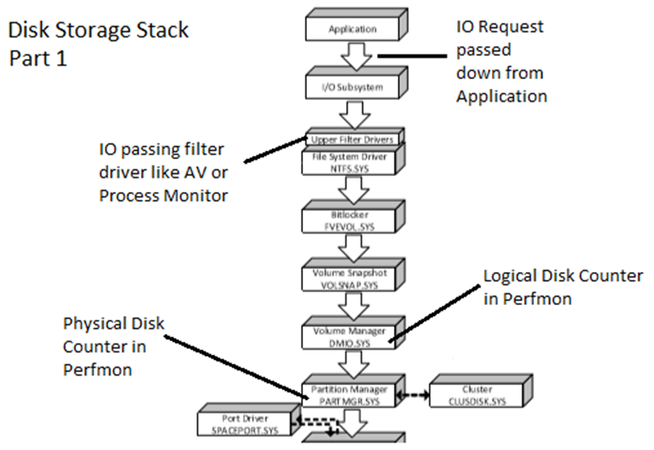
Disk Storage Stack Part 1
Notes:
https://blogs.technet.microsoft.com/bulentozkir/2015/04/10/windows-disk-storage-stack/
https://technet.microsoft.com/en-us/library/ee619734(v=ws.10).aspx
More detailed:
https://docs.microsoft.com/en-us/windows-hardware/drivers/storage/storage-driver-architecture
https://docs.microsoft.com/en-us/windows-hardware/drivers/ifs/storage-device-stacks--storage-volumes--and-file-system-stacks
Performance Tuning for Storage:
https://msdn.microsoft.com/en-us/library/windows/hardware/dn567655(v=vs.85).aspx

Slide 21
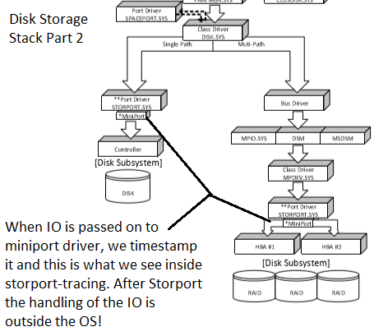
Disk Storage Stack Part 2

Slide 22
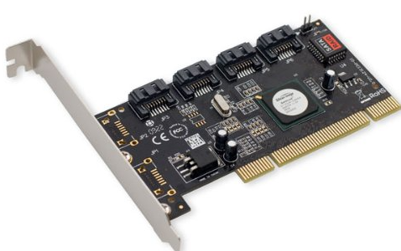
RAIDs (already a virtualized storage)
Use local physical storage via a RAID-Controller to increase capacity, performance or data security
Basic Raid types are
Raid 0 = Stripping
Raid 1 = Mirroring
Raid 5 = Striping with Parity
Raid 6 = Striping with Double Parity
Complex Raid types are
Raid 0+1 = Stripping and Mirroring
Raid 5+0 = Striping RAID 5 sets
Notes:
Talk briefly about the possible raid types
https://en.wikipedia.org/wiki/Nested_RAID_levels
https://www.acnc.com/raid

Slide 24
Virtual Storage

Slide 25
Learnings covered in this Unit
JBODs & Raids
Network Attached Storage
Physical and Logical Disks
Storage Spaces

Slide 26
JBODs & Raids

Slide 27

Virtual Storage
JBODs & Raids
NAS,SAN,iSCSI,VHD/VHDX,ThinProvision,StorageSpaces,S2D
Virtual storage means you can no longer take the „disk presented to Windows“ into your hands.
Notes:
When seeing a physical device in Device Manager, we tend to believe that we have exclusive access to that device. If that device is only a virtual device other parties might use the „same base“ which is used to present us our physical device. This means we accutally do not know what our „physical device“ is cabable of.

Slide 28
JBODs & Raids
JBOD = Just a bunch of Disks
Hardware enclosure with multiple disks
No intelligence build into enclosure
Can be used for Storage Spaces
Can be used for Software Raids
RAIDs = Redundant Array of Independent Disks
Controller to combine multipe Disk to genreate virtual disk(s)
Different type of Raids are possible
Typical : Raid 0 / 1 / 5
Requires more than 1 disk
Notes:
https://en.wikipedia.org/wiki/Non-RAID_drive_architectures
https://en.wikipedia.org/wiki/RAID

Slide 29
RAID 0
RAID 0: Striping without Parity
Fastest read and write I/O performance
1 I/O per Read/Write Operations
No redundancy
0% loss of disk capacity usage
High risk of data loss
Recommneded for temporal data only
Image from Creative Commons

Slide 30
RAID Types
RAID 1: Mirroring
Fast read performance (1 I/O per read *2 disks) = 2x read performance
Average write performance (2 I/Os per write) = 1x write performance
Redundant – Can lose 1 disk and still remain operational
50% loss of disk capacity usage
Image from Creative Commons

Slide 31
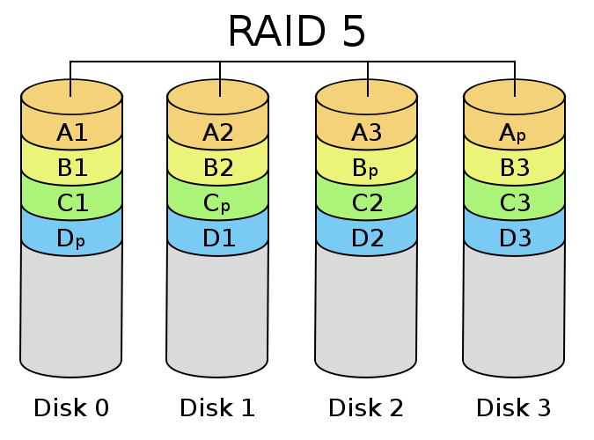
RAID Types
RAID 5: Striping with Parity
Best for redundancy and disk capacity usage
Fast read performance (1 I/O per read) * n number of disks
Very poor write performance (4 I/O’s per write)
Can lose 1 disk and still function
12-33% loss of disk capacity usage (depending on number of disks)
Image from Creative Commons
Notes:
Talk briefly about CPU overhead on Software Raid 5 and why a hardware controller is recommended. Also talk about Risks during rebuilds

Slide 32
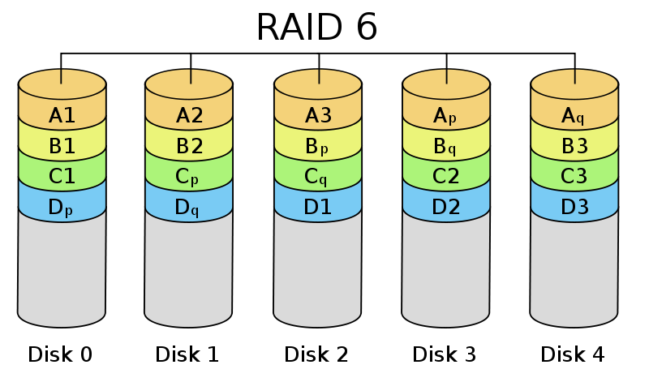
RAID Types
RAID 6: Striping with Double Parity
As Fast as RAID 5 on reads (1 I/O per read) * n number of disks
Minimum number of disks required: 4
Worst write performance (5 I/O’s per write due to extra parity write I/O vs. RAID 5)
Faster rebuilds than RAID 5
25-50 % loss of disk capacity usage
Even slower than RAID 5 for writes
Image from Creative Commons

Slide 33
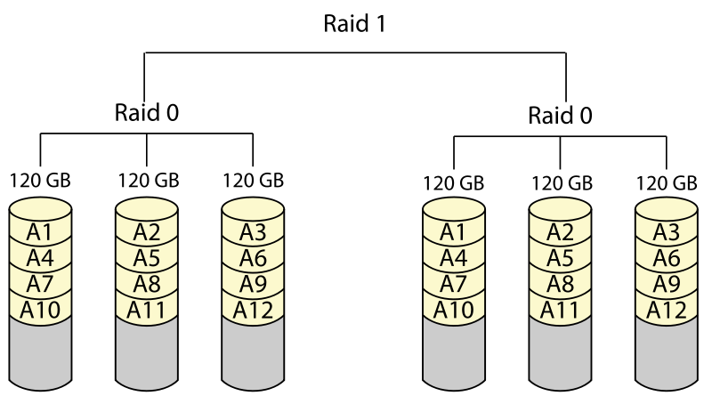
RAID Types
RAID 0+1: Striping with Mirror
It is preferable to have RAID 0 on top and the RAID 1 array at the bottom, because fewer disks then need to be regenerated when a disk fails
Fast read performance (1 I/O per read *2 disks) = 2x read performance
Minimum number of disks: 4
Fastest of the 0-6 RAID options
Average write performance (2 I/Os per write) = 1x write performance
Image from Creative Commons
Notes:
Minimum Disks required: 4 !

Slide 34
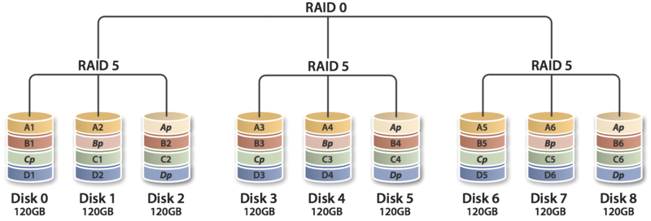
Advanced RAID Types (SAN striping Metas)
RAID 50: Striping RAID 5 sets
As Fast as RAID 5 on reads (1 I/O per read) * n number of disks
6 Disks required
Approximate N/1 improved write performance vs. RAID 5 set (3 sets is 30% faster than a single RAID 5 set).
This is frequently used format by Storage teams.
1 drive from each of the RAID 5 sets could fail without loss of data
RAID 50 improves upon the performance of RAID 5, particularly during writes
Image from Creative Commons

Slide 36
Network Attached Storage

Slide 37

NAS (Network Attached Storage)
File-level computer data storage that is connected to a TCP/IP Ethernet network
Uses Server Message Block (SMB), Network File System (NFS), or other network protocols
Available via Universal Naming Convention (UNC) network paths (\\svr\share) or in some cases as DAS
NAS Controllers
NIC
\\svr\share1
TCP/IP
NIC
Other NAS
\\svr\share2
Notes:
An NAS is file-level computer data storage that is connected via a TCP/IP Ethernet network.
To access data on a NAS, a UNC network path is needed.
An NAS uses the Server Message Block (SMB) network communication protocol.
An NAS hardware device or appliance might or might not be running a Windows Server OS, and it is effectively a Windows file server on the network.
Computers access an NAS device as if it was a Windows file share by using the UNC naming convention, such as \\srv\share.

Slide 38
iSCSI
A gigabit, IP-based storage networking standard for linking data storage facilities
A protocol suite that makes it possible for SCSI commands to be encapsulated and transmitted over the TCP/IP stack
To access the iSCSI network, computers use an Ethernet Network Interface Card (NIC)
SAN Controllers
iSCSI
NIC
LUN 1 and 2
TCP/IP
NIC
Other SANs
LUN 1 and 2
Notes:
iSCSI encapsulates and transmits SCSI commands using TCP/IP over Ethernet. Unlike an NAS device, which accesses data via a UNC path, iSCSI can present one or more LUNs to computers that are bound to it.
The LUNs appear as local disk drives to the computers. Windows Server 2012 ships with an iSCSI target driver. When using iSCSI, it is important to enable Jumbo Ethernet frames, TCP Offloading, RSS scaling, and NetDMA features for Windows Server 2008 and Server 2012.
For implementation details, see: http://support.microsoft.com/kb/951037

Slide 39
SAN and Fibre Channel (FC)
A SAN is a network of storage resources
A SAN consolidates and shares storage media, using hardware efficiently
Computers connect to one or more SANs by using a Host Bus Adapter (HBA) to connect to a FC network
FC is a gigabit-speed network technology over fiber-optic cables that is primarily used for network storage
SAN
Fibre Channel or
SAN fabric
SAN Controllers
LUN 1 and 2
HBA
Fibre Channel
switch
HBA
Other SANs
LUN 1 and 2
Notes:
A SAN is a network of physical spindles that is managed by one or more controllers.
HBAs are physical cards that are installed on computers that need to access a SAN. HBAs access one or more SANs by using a Fibre Channel (FC) network, which uses fiber optic cables. Zero or more FC switches can be used to manage the network traffic between HBAs and SANs.
A SAN presents DAS LUNs to the HBAs, giving the computers the appearance of local physical disks.

Slide 41
Physical and Logical Disks

Slide 42
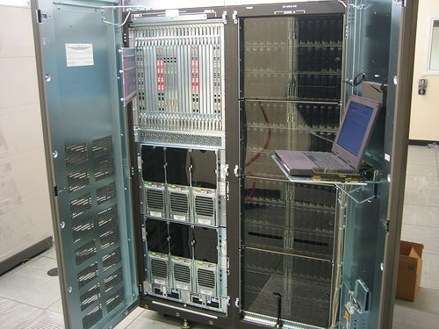
Deep dive into virtual Storage
Notes:
A physical disk is represented to Windows and Windows Server as a LUN. Physical disks are shown in the left pane of Disk Manager (see the screenshot in the slide). Multiple logical disks can be on a single physical disk, and a logical disk can be stripped across multiple physical disks.

Slide 43
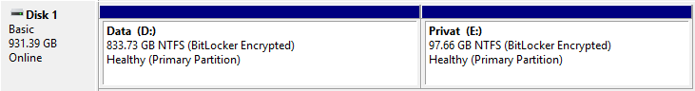
Physical Disks and Logical Disks
Physical disk:
An “device” that is presented to the Operating System (OS)
Unknown hardware behind the LUN—unknown spindle(s)
Logical disk:
Used to create a partition and install a file system onto it (like c:\)
Multiple logical disks can exist on a physical disk, and vice versa
Mount points (c:\clusterstorage)
Physical disk Logical disk
Notes:
A physical disk is represented to Windows and Windows Server as a LUN. Physical disks are shown in the left pane of Disk Manager (see the screenshot in the slide). Multiple logical disks can be on a single physical disk, and a logical disk can be stripped across multiple physical disks.

Slide 44
Typical Storage Speed Expressions
SAN, NAS, and ISCSI usually express connection speeds in Gigabits per second (Gb/s), whereas hard drives typically express speed in Megabytes per second (MiB/s)
Gigabits to Megabytes conversion*:
GB/sec / 8 = MiB / Second
GB/sec | 10 GB/sec | 1 GB/Sec | 100Mbit | 10Mbit
MiB/Sec | 1 220 MiB/sec | 122 Mib/Sec | 12.2 MiB/sec | 1.22
Notes:
It is important to understand what the performance of modern interconnect technologies are, so that as we contemplate how many I/O Operations Per Second (IOPS) a server would need to service a particular Logical Unit Number (LUN), we have a rough idea of how many hard drives an interface can handle.
To get Gigabits per second into Megabytes notation, we need to divide bits by 8 to get an MB/sec notation. Therefore, 1Gbps is (1,024,000,000 bits/8), 2Gbps is (2,048,000,000 bits/8), 4Gbps is (4,096,000,000 bits/8), 8Gbps is (8,192,000,000 bits/8), and 10Gbps is (10,485,760,000 bits/8).
http://en.wikipedia.org/wiki/IOPS
*Signaling overhead, bandwidth sharing, and other topology factors may lower the actual true output, so these are expressed as the theoretical maximum

Slide 45
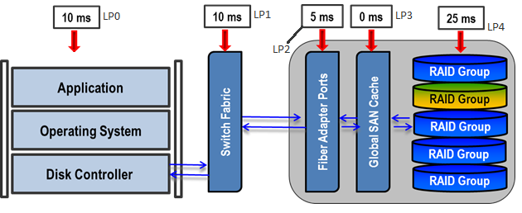
What is Latency in virtualized storage?
Latency describe the time passed of an IO-Request send to the disk and the confirmation is received
Latency occurs because there are multiple places where bottlenecks can occur between the physical hard drive and the application requesting the data
Where LP represents a typical Latency Point:
LP0+LP1+LP2+LP3+LP4 = 50 ms of total latency in this example
Notes:
What this slide is trying to communicate is that there are multiple levels and devices typically involved in getting data to and from a storage device. In its simplest form there is the hard drive latency itself, and the disk controller which must process the Redundant Array of Independent Disks (RAID) overhead when there are multiple hard drives involved.
In remote storage scenarios, such as a Network Attached Storage (NAS) or a Storage Area Network (SAN):
The number of intermediate devices increases to include a Host Bus Adapter (HBA)-controller in the server, fiber optic switches
The communication ports in the storage device called fiber adapter ports (think of an HBA for the device), the cache in the storage device
The collection of hard drives typically chained together in a RAID format of some kind typically called a RAID group as a collection of hard drives virtually chained together in the back-end of the storage device
Hardware components on this kind of scenario usually include:
HBA adapters in the server
Fiber channel switches
Inter-switch links
Front-side adapters
A disk array cache
Processors, RAM, and disk controllers
Disk drive media to include different kinds of hard drives
In addition, there are layers of software on this path, including various drivers, firmware, and APIs. This is just a long form way to say that all of these software and hardware components in the I/O path has the potential to significantly alter the performance characteristics of a LUN presented from the remote storage device like an Internet Small Computer System Interface (iSCSI), NAS, or SAN.

Slide 46
Typical Bottlenecks in SAN as example
The HBA may need its Queue Depth adjusted
The Switch Fabric may be oversubscribed (congestion)
HBA cache settings might be incorrect
The FA ports may be public and may not be able to handle the peak load of this server and other servers using the same fiber adapter port (congestion)
The RAID group in the SAN may not have sufficient Iops to handle the load with acceptable latency
Fiber Adapter Ports
Global SAN cache
RAID Groups
RAID Groups
HBA
Switch Fabric
RAID Groups
RAID Groups
RAID Groups

Slide 47
Shared Harddisk / Spindles
Used mainly to bring down storage costs as not every server require high performance storage
Increases utilization of the storage
Physical spindles that are used by or shared with other computers
Higher potential for unreliable or inconsistent IOPS and response times than dedicated spindles
Spindles (and potentially controllers) are pooled together and share the load
Less likely to have idle spindles compared to a dedicated spindle model
Some servers might have better or worse disk performance
Good or poor performance can affect multiple servers
Notes:
Now that SAN technology has arrived, Windows Server administrators can share spindles across multiple servers, allowing all of the spindles to be used (so they are less likely to be idle) and maximizing the monetary investment in hardware. If the shared spindles become performance saturated, this can affect all of the servers with a LUN attached to the same spindles being shared.

Slide 48

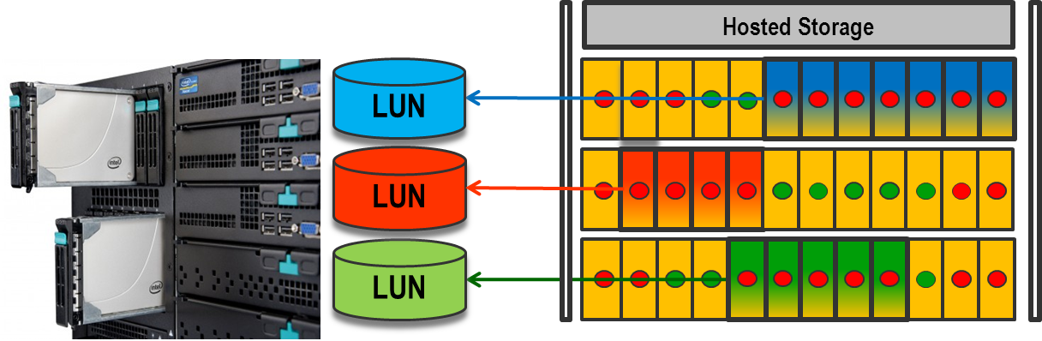
How LUNs are Made in a typical SAN
A LUN is usually made of portions of multiple disks that are loosely grouped together to create a virtual hard drive for a server
Each represents a hard drive that has its total space divided into 4 parts (example: 250 GB of a 1 TB hard drive)
Notes:
A storage array or JBOD is a direct attached storage that is very close in physical proximity to the physical server. The server might see each spindle as an individual disk, or the hardware controller might consolidate the spindles into one or more LUNs.
This is usually accomplished by taking chunks of a specific hard drive’s total storage space (such as previously discussed a quarter of a 1 TB hard drive), then taking multiple chunks from multiple different hard drives to create a virtual hard drive. This is usually called a RAID group, but terms like a MetaLUN (EMC), vRAID (HP), etc. can also be in the description depending on the storage vendor and their terminology.

Slide 50
Storage Spaces

Slide 51
Microsoft´s Storage spaces
Software based SAN running on Windows
Used with SAS-Drives and JBOD´s
Add multiple disks to pools
Option to use tiering
Able to utilize different types of drives
Reducing costs of storage
Able to run different types of resiliency (Mirror / Parity)
Notes:
Storage Spaces in 2012:
https://docs.microsoft.com/en-us/previous-versions/windows/it-pro/windows-server-2012-R2-and-2012/hh831739(v=ws.11)
S2D in 2016:
https://docs.microsoft.com/en-us/windows-server/storage/storage-spaces/storage-spaces-direct-overview

Slide 52
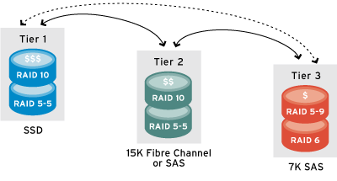
Tiering in Storage Spaces
Tier 1 is usually SSD with cache
Tier 2 is usually 10k or 15k 2.5” disks capable of 400-600 IOPs
Tier 3 is usually 7,200 or 5,400 3.5” drives that are used for 80% read, 20% write scenarios. This is usually where data is housed just before being archived to Tier 4 – Backup or Tape.
Notes:
Tier 2 is PMR, Tier 3 can be PMR or SMR

Slide 53
Knowledge Check
Why is an access time of 15 ms or more generally considered slow?
What is the difference between a physical disk and a logical disk from the perspective of Windows and Windows Server?
What is the difference between software and hardware RAID?
Why are storage problems hard to troubleshoot?
Notes:
Question 1 Answer:
Because 15 ms is the uncached access time median between 5400 and 7200 RPM hard disks, response time averages above it are generally considered slow
Question 2 Answer:
A physical disk is a direct attached storage device that is presented to Windows or Windows Server. It is also called a LUN
A logical disk is a disk volume that has a drive letter or that is a mount point
Question 3 Answer:
Hardware RAID consolidates multiple hard drives into a single LUN that is presented to Windows or Windows Server
Software RAID is where Windows or Windows Server consolidates multiple LUNs
Software RAID is visible in Windows using DiskMgmt
Question 4 Answer:
We need to involve multiple teams and we are not aware about the physical hardware used for a specific server in shared storage scenarios

Slide 54
Introducing Disk Performance counters & Concepts

Slide 55
Learnings covered in this Unit
PhysicalDisk and LogicalDisk Counter Objects
Disk Counters
Disk Queue
Queue Depth vs. Bandwidth issues
Troubleshooting Flow
Process I/O Counters

Slide 56
PhysicalDisk and LogicalDisk Counter Objects

Slide 57
PhysicalDisk and LogicalDisk Counter Objects
PhysicalDisk counters:
Measure “physical device” performance
Hardware RAID, disk virtualization, and I/O distribution can make measurements difficult to assess
Part of Partition Manager
LogicalDisk counters:
Measure performance of lettered drives
Logical disk counters are usually more relevant to applications and services
Example: drive D:, E:, or D:\Disk1\BackupDrive7
Part of Volume Manager
Notes:
The PhysicalDisk counter object measures how many LUNs are attached to the computer. Hardware RAID can make many physical spindles appear as a single physical disk to Windows and Windows Server. However, what appears to the computer to be a single physical disk might not actually be a single physical disk. This virtualization of physical disks can complicate the analysis of disk performance.
The LogicalDisk counter object measures logical disk drive letters and mount points. A logical disk can span multiple physical disks, and there can be multiple logical disks on a single physical disk.
If you do not know what the physical architecture of the disk subsystem looks like, generally start with the LogicalDisk counter object. This is because it is the closest measurement of file–to-process disk performance that you can get from performance counters.

Slide 58
Disk Counters

Slide 59
Disk Counters
Primary counters:
Avg. Disk sec/Read
Avg. Disk sec/Write
These counters show disk latency. How long did the data take to access?
Secondary counters:
Disk Transfers/sec
Disk Bytes/sec
Avg. Disk bytes / read (write)
Avg. Disk Queue Length
Current Disk Queue Length
These counters measure the amount of disk activity. How much data is being accessed?
Notes:
Counters are separated into two sets, Primary and Secondary.
Primary counters are used to identify if a bottleneck exists
Secondary counters are used to help narrow down where the bottleneck may be (JBOD or Fabric)

Slide 60
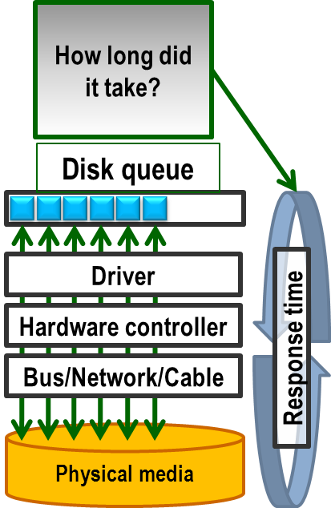
Avg. Disk Sec/Read or Write
Avg. Disk sec/Read and Avg. Disk sec/Write are the average times, in seconds, of read or write operations respectively
Also called “latency”
An initial indicator of disk performance
Part of the “Logical Disk” and “Physical Disk” counter objects
Implemented at higher level in the Storage stack
Notes:
The best initial indicator of how the disk is performing is the average response time for servicing IRPs.
The Avg. Disk sec/Read and the Avg. Disk sec/Write performance counters measure the response times of every IRP and calculate the response times between counter collections. These counters are nearly as accurate as the disk driver class. These counters are often used synonymously with disk response times.

Slide 61
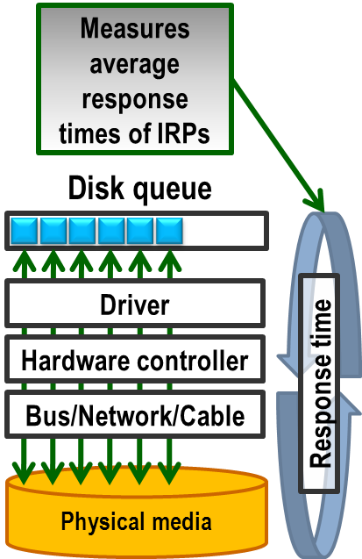
Avg. Disk Sec/Read or Write (continued)
Software and hardware disk cache can greatly affect disk latency
Disk latency is a reliable measure of disk performance
Compare to the access time in the hardware specification of the bus/network/cable and the physical media
Example: A 7200 RPM disk drive should respond faster than 13 ms
A floppy drive usually responds within 600 ms
Notes:
If the disk hardware can keep up with the I/O request packet load, the response times are as fast or faster than the disk access times (the worst case amount of time needed to get data off of a disk).
If there are more I/O requests in the disk queue than can be serviced by the disk in a timely manner, the average IRP response times increase accordingly.
This is why the Avg. Disk sec/Read and Avg. Disk sec/Write counters are important initial indicators of disk performance.

Slide 62
Thresholds for Avg. Disk sec/Read or Write
Response times longer than 15ms over a period of 1 min or more (based on average I/O sizes of 64 KB or smaller) impact performance
One time spikes up to 50ms in response times are normal and not an issue for the operating system.
Applications (SQL, Exchange) might have different thresholds.
Threshold if observered over a period of 1 minute or longer | Effect
15 ms or less | Informational Normal usage
More than 15 ms | Warning Performance might be affected
More than 25 ms | Critical Performance very likely affected
Notes:
The 15 ms (0.015) warning threshold for Avg. Disk sec/Read and Avg. Disk sec/Write is based on response times for 64 KB or smaller.
A 7200 RPM disk drive can generally respond faster than 13 ms, based on its access time and assuming I/O sizes of 64 KB or smaller.
Therefore, if the average response time is greater than its worst case response time and the I/O sizes are 64 KB or smaller, the disk is performing poorly.
If you suspect poor disk performance, follow the common next steps listed in the slide.
Other server products such as Exchange, Active Directory, and SQL server have more stringent latency requirements, typically at the 5 ms to 10ms level. See their performance requirement whitepapers for the latest latency specifications.

Slide 63
Common next steps to troubleshoot
Check I/O sizes more than 64 KB
If the hardware is shared, consider using dedicated hardware
If you are using spinning media, consider defragmenting
Adjust the hardware cache
Consider using faster media
Reduce unnecessary I/O
Check hardware for failures or faults

Slide 64
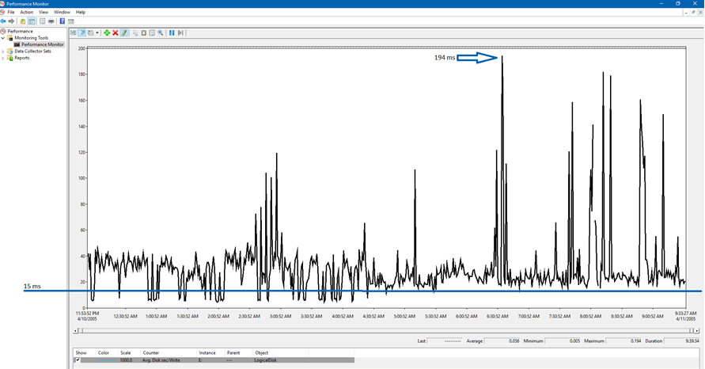
Example of Avg. Disk sec/Write
In this case, drive E: frequently has response times above 15ms, up to 194ms.
Notes:
In the example in this slide, the counters are in the unit of seconds, so the value of 0.025 equals 25ms on the Avg. Disk sec/Read and Avg. Disk sec/Write performance counters. The disk response times are greater than 25ms on average.

Slide 66
Disk Queue

Slide 67
Disk Queue Counter
Disk queue
Avg. Disk Queue Length counter
Example of Avg. Disk Queue Length

Slide 68
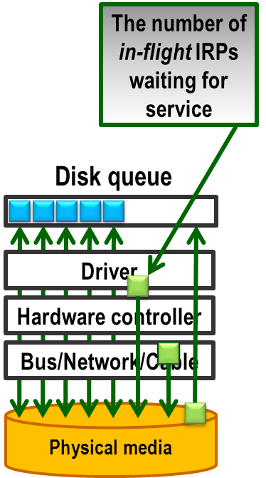
Disk Queue
Each disk has a disk queue
The disk queue length is the number of in-flight IO´s
One or more IO´s can be serviced at the same time, depending on the physical media
IO´s might be reorganized by a driver to optimize the physical media
Example: The HBA queue depth determines how many I/Os a SAN can service simultaneously
Notes:
Each disk has a disk queue, which lists the in-flight IRPs that have not been serviced yet. Some disk drivers might retrieve the I/Os in a different order than the order they were received in.
For example, if the disk queue received three I/O requests in the order 1-2-3, the disk driver might retrieve the I/Os from the physical media in the order 3-1-2. This might be for various reasons, such as disk rotation or location on the spindle. The point is that the I/O requests in the disk queue might not be serviced in a First In First Out (FIFO) order, causing some of the I/O requests to wait longer than others.
Moreover, some disk hardware (such as a host bus adapter (HBA) of a SAN) might be able to handle more than one I/O request at a time.

Slide 69
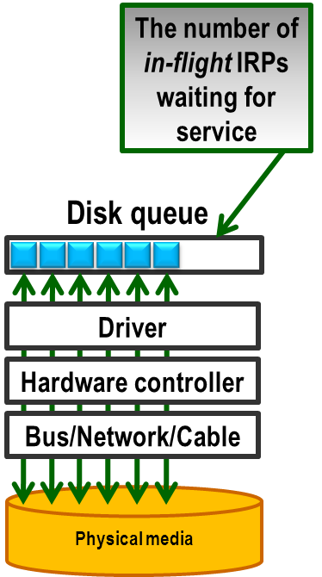
Avg. Disk Queue Length Counter
The Avg. Disk Queue Length counter is the average number of both read and write requests that are queued and waiting to be serviced for the selected disk during the sample interval
Part of LogicalDisk and PhysicalDisk counter objects
Due to disk virtualization and I/O distribution, no threshold can be assigned
Look for increasing trends
Linked with %idle time counter for the disk which might be easier to understand
Notes:
The Avg. Disk Queue Length counter is a calculated value that measures the average number of both read and write requests that are queued or waiting to be serviced for a selected disk during a sample interval.
Traditionally, performance counters that relate to the disk queue, such as Avg. Disk Queue Length, % Idle Time, and % Disk Time, have been staples in the IT professional’s tool belt.
The counters have great value when analyzing single spindle disks, but they are less effective when more spindles are added to a LUN or when spindles are shared between LUNs. For example, if Avg. Disk Queue Length is 2 and there are 10 spindles behind the LUN, the LUN should have no problem with handling the load (assuming an equal distribution of those I/O requests to physical spindles). This is like having 10 checkout lines with an average of only two people wanting to check out.
Even if the number of physical spindles is known, it is still difficult to apply a threshold to the Avg. Disk Queue Length because of disk virtualization, hardware cache, and many other variables. Many system administrators use a warning threshold of 2 + number of spindles, but the response times still must be considered. Similarly, if you are in line to buy a cup of coffee and there are 40 people in front of you, you might assume that the length of the line (the queue) predicts your wait time for service. However, what if you receive your cup of coffee within a few seconds? Does it matter that there were 40 people in the line?
The point is that knowing the length of the disk queue is helpful as supplemental information, but with disk virtualization, you cannot afford to make assumptions. This is why disk response times are the best indicators of disk performance.

Slide 70
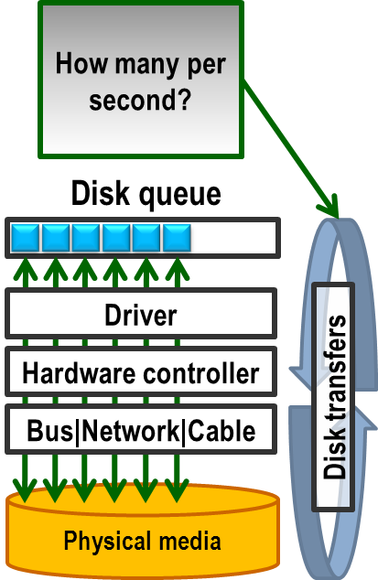
Disk Throughput Counter
Disk Transfers/sec is the rate of read and write operations on the disk
Use this counter to establish a performance baseline
Shows the number of serviced IOs per second
Part of the LogicalDisk and PhysicalDisk counter objects
Disk Transfers = Read+Writes
Notes:
Disk Transfers/sec is the rate of read and write operations on the disk. This is from the perspective of the OS, and it might correlate with more I/Os on the hardware. This counter can help determine the amount of I/O throughput on the disk. Disk hardware and performance can differ greatly, so there is no generic threshold for this counter. With that said, for a given disk, try to establish the baseline performance, and then compare that baseline if you suspect poor performance.
For example, if you know the disk can sustain 1000 disk transfers per second and stay within 10 ms response time, but you later find a response time of 50 ms with only 200 disk transfers, this might indicate a problem with the disk hardware, such as can be the case with physical spindles shared between multiple servers. Therefore, if you suspect poor disk performance, you can compare the performance to the baseline.
Use this counter to establish a performance baseline that you can compare to if you suspect poor performance.

Slide 71
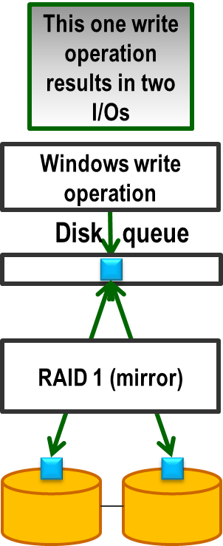
Back End vs. Front End IOPs
Disk Transfers/sec shows the local IO´s
Number of IO´s might change in the backend
Cache
Raid-Overhead
Stripe Size
IO´s have a close relationship to
Blocksize (4kb – 1MiB)
Latency
Each IO requires also CPU-Power
Notes:
Disk Transfers/sec measures the read and write operations of the OS, but it is not the same as the actual IOPS on the disk hardware. For example, a single write operation on a hardware RAID 1 mirror set might result in 2 or more I/O’s sent to the storage device. So, 100 Disk Transfers sent to the Logical drive may require the hardware to generate 200 I/O’s to service the requests. Where we measure the IOPS.
If you are trying to determine the performance needs of a LUN and you are talking to a storage admin, then they will be figuring out the RAID penalty on your behalf to determine how many hard drives will be needed, so they need to be told the Disk Transfers/Sec rates as IOPS and total bytes sent.
Bytes Per Second total work would be Disk Transfers/Sec * TransferSizeInBytes = BytesPerSec.
Regardless of the number of physical spindles in a RAID 5 set, it is generally about 4 I/Os (2 reads, 2 writes), depending on the implementation, to complete a write operation:
One I/O to read the data bit
One I/O to read the parity bit, modify data
One I/O to write the data bit
One I/O to write the parity bit
Working Formula: Total IOPs = ((Reads)+(Writes * RAID penalty)) of back-end disk requirement to meet it.
So for a RAID-5 array where an application generates 1000 IOPs of activity where Reads are 60% and Writes are 40%. The Reads and Writes percentages are derived by observing the ratio between the Perfmon Logical or Physical disk object Reads/sec counter vs. the Writes/sec counter.

Slide 72
Local IO vs Backend IO in raid configuration
Rule of thumb for raid overhead
RAID Type | IO Penalty | Result
RAID 1 | 2 | Reads+( Writes x 2 RAID I/O overhead)
RAID 0+1/1+0 | 2 | Reads+( Writes x 2 RAID I/O overhead)
RAID 5 | 4 | Reads+( Writes x 4 RAID I/O overhead)
RAID 6 | 6 | Reads+( Writes x 6 RAID I/O overhead)

Slide 74
Queue Depth vs. Bandwidth issues

Slide 75
Detailed look on Queue Depth vs. Bandwidth issues
Virtualization can express Queue Depth issues much sooner than actual Bandwidth consumption issues.
Boot of Windows 10 normally requires around 1 GB of data during boot
On the Disk, and Network Interface objects this can become very important to be aware of an monitor. Most IT professionals can generally assess Memory and Processor from Task Manager.
It is not uncommon to require 2-4 NIC team pairs and 2-4 HBA’s to accommodate all of the parallel requests ‘in flight’ on the host hardware by multiple guest VM’s.

Slide 76
Perfmon Storage Analysis Technique
Most LUN’s presented to a server are usually made of different hyper or meta LUN’s (different RAID groups back in the SAN)
This means that by looking at multiple drives at the same moment in time in Perfmon we can usually infer if it is systemic behavior common to an HBA or the fiber path.
Single instance latency issues usually mean the issue is specific to the RAID group in the SAN.
Controller can handle the load
Issue on the BackEnd
Multiple instances of latency usually means the issue is at the HBA or Fiber path layer.
Controller might be overloaded
Once Data reaches BackEnd, the handling is fast
Issue is on the way towards the backend

Slide 77
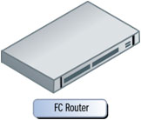


Identifying SAN vs. Host/Fiber Network issues
If only 1 drive has high latency at a given moment in time, then the shared HBA and Fiber network is okay, and the problem is most likely at the FA port/Cache/RAID group in the SAN.
If multiple drives have high latency at a given moment in time and are performing I/O. Then the shared HBA or fiber network is much more likely to be suspect.
Fiber switch
SAN
High latency in this RAID group
High latency due to over subscription
All drives have latency
Fiber switch
SAN
High latency
Fiber switch
SAN
All drives have latency
Notes:
Spend a lot time here on this slide and the next to master this concept. This technique is a very powerful to accurately infer where the bottleneck usually is.

Slide 78
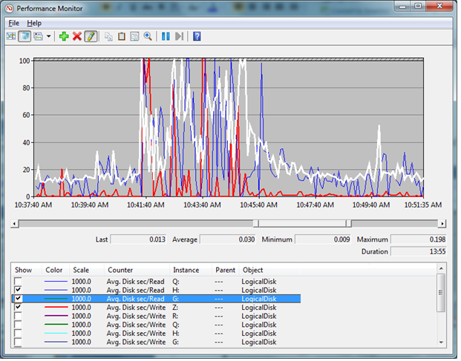
Analysis Example
Notice that drive Z:\ (red line) dies not show high latency at the same moment H:\ and G:\ do. This means that there was no systemic saturation of the HBA or Fiber path at the moment in time or *all* drivers performing I/O would show heavy latency at the time sample. This means the latencies observed are most likely issues with the RAID group in the SAN.
Notes:
Spend a lot time here on this slide and the next to master this concept. This technique is a very powerful to accurately infer where the bottleneck usually is.

Slide 79
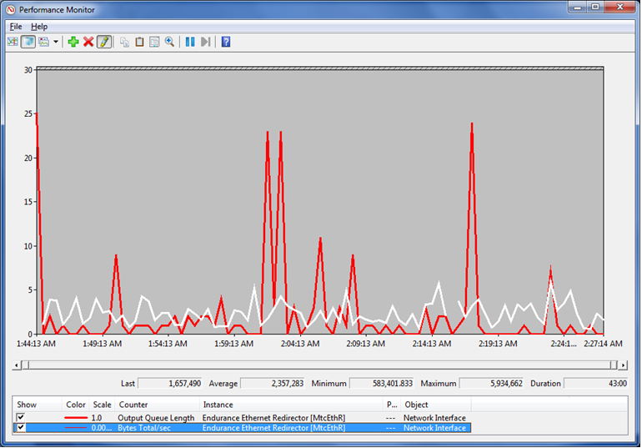
Queue Depth analysis example - NIC
Notice that the NIC queue depth (red line) spikes up even when Bytes/sec (white line) is declining. This is the inability to juggle all outstanding requests.

Slide 80
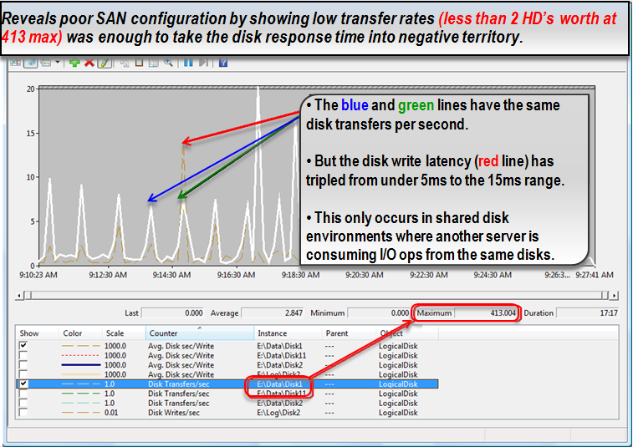
Queue depth analysis example - Disk
Notes:
Sample Interval: Since disk I/O's are measured in milliseconds, you want to capture Perfmon with a 2-3 seconds interval (1 second interval could be too taxing to the server)
I/O Latency is measured by using Avg. Disk sec/Read and Avg. Disk sec/Write counters.
Windows timestamp the IRP being sent by Partition Manager down the stack, and when it arrives back Windows timestamp it again and calculate the time difference (PERF_AVERAGE_TIMER)
The table below describes the access time (average latency+random seek), based on vendors specifications.
Device Access Time (ms)‎1
5400 RPM hard disk 17
7200 RPM hard disk 13
10K RPM hard disk 8
15K RPM hard disk 6
Solid State Drive (SSD) Disk 0.2
1. Full stroke uncached access
Theses thresholds are based on I/O sizes of 64 KB or smaller. For example: If the average size of I/O requests is 128 KB you should double the expected thresholds. You can check the average I/O size by using the Avg. Disk Bytes/Read and Avg. Disk Bytes/Write counters (Any other issues concerning I/O size above 64KB?)
Spikes
Rule of thumb: Quick spikes in response times are common and normal.
• PAL tool definitions:
o More than 20ms considered slow (warning)
o More than 50ms considered very slow (critical)
• PMA tool definitions:
o More than 30ms considered slow (warning)
% Idle Time
The % Idle Time counter reports the percentage of time that the disk queue is empty.
The official recommendation is watch for sustained periods of less than 10%.
Consider the following scenarios:
Scenario Excepted value
Heavy load system drive N/A (0 can be valid)
System or Pagefile drive More than 10%
Virtualized environment N/A (0 can be valid)
Use other counters to figure out how many outstanding IRPs are out there, and if the LUN can handle them fast enough
Avg. Disk Queue Length
Avg. Disk Queue Length is equal to the (Disk Transfers/sec) *( Disk sec/Transfer). It is important to note this is a derived value and not a direct measurement.
Again, because it’s an average value, it takes more account of extreme values. This requires us to validate both Avg. Disk Write Queue Length and Avg. Disk Read Queue Length in case of disk write cache is enabled.
Rating Value SAN Environment
Excellent 2 * number of spindles Less than 16 (SCSIport), or 32 (Storport)
Good 4 * number of spindles More than 16 (SCSIport), or 32 (Storport)
Fair 6 * number of spindles More than 16 (SCSIport), or 32 (Storport)
This value is aggregated from all paths used in MPIO. We must divide it by the number of paths used. For example: 4 HBA with 2 ports will have 256 paths (4*2*32). In that case, value of 1000 Avg. Disk Queue Length will be fine, as each path will have queue length of 4 (1000/256).
Current Queue Length
Current Disk Queue Length is a direct measurement of the disk queue present at the time of the sampling. You need to have multiple occurrences to conclude something.
Rating Value SAN Environment
Excellent 2 * number of spindles Less than 16 (SCSIport), or 32 (Storport)
Good 4 * number of spindles More than 16 (SCSIport), or 32 (Storport)
Fair 6 * number of spindles More than 16 (SCSIport), or 32 (Storport)
Since this is always measured on one LUN, the maximum is 255, which should never be approached
Disk Bytes/sec
Perfmon captures the total number of bytes sent to the disk (write) and retrieved from the disk (read) over a period of one second. If the Perfmon capture interval is set for anything greater than one second, the average of the values captured is presented.
The Disk Read Bytes/sec and the Disk Write Bytes/sec counters break down the results displaying only read bytes or only write bytes, respectively
Avg. Disk Bytes/Transfer
Displays the average size of the individual disk requests (IO size) in bytes, for the capture interval. Example: If the system had ninety nine IO requests of 8K and one IO request of 2048K, the average will be 28.4K. Calculation = (8k*99) + (1*2048k) / 100
The Avg. Disk Bytes/Read and Avg. Disk Bytes/Write counters break down the results showing the average size for only read requests or only write requests, respectively.
(For Windows Server HC: since the sample interval will be 2-3 seconds, there is no need to collect both of these counters, just the Avg. Disk (*)/Transfer)
Disk transfers/sec
Don’t confuse between how many IOPS a device can have and the limits on the number of bytes. When the disk is close to the maximum number of IOPS it’s considered saturated.
Device IOPS
5400 RPM hard disk 80
7200 RPM hard disk 100
10K RPM hard disk 150
15K RPM hard disk 200
Solid State Drive (SSD) Disk 5,000
* Sequential
In order to see how IOPS are affected by each RAID configuration, let's see how each type of the RAID levels change the calculation
RAID Type Write penalty
RAID 0 1
RAID 1 2
RAID 5 4
RAID 6 6
RAID 0+1 2
Split IO/Sec
Measures the rate of IO split due to file fragmentation. This happens if the IO request touches data on non-contiguous file segments.
This value should be close to zero.
% Free Space
Display the percentage of the total usable space on the selected logical disk that was free.
Defrag requires at least 15% of free space
Threshold Effect
More than 15% Fair
Less than 15% Warning
Less than 5% Critical

Slide 81
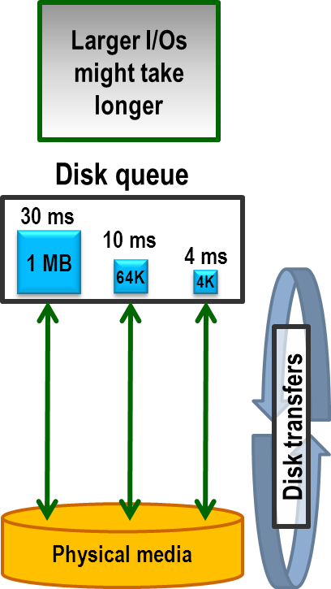
I/O Size Counters
The size of the read and write operations (IRPs) can affect the response times
Use Avg. Disk Bytes/Read and Avg. Disk Bytes/Write counters to determine the I/O sizes
The threshold of a 15ms response time is based on I/O sizes of 64 KB or smaller
Part of LogicalDisk and PhysicalDisk counter objects
Notes:
The size of the I/Os can significantly affect the response times of the I/O requests. A 1 MB I/O request is 256 times larger than a 4 KB I/O request, so it needs more time to be serviced.
For this reason, if you observe disk response times greater than 15 ms, check the average I/O size by using the Avg. Disk Bytes/Read and Avg. Disk Bytes/Write counters. The threshold of 15 ms disk response time is based on I/O sizes of 64 KB or smaller, so average I/O sizes larger than 64 KB might take longer than 15 ms and still be considered a good response time. I/O size can affect the total number of Disk Transfers/Sec or IOPS send. However, a 1 MB I/O request is 1 I/O request or IOP, but it can generate 125 I/O operations on the local disk controller or back in the SAN.
If you regularly deal with average I/O sizes larger than 64 KB, consider establishing a disk performance baseline while performance is good. Use the baseline to compare to suspected poor performance. Moreover, consider looking at the actual data throughput of the disk by using the Disk Bytes/sec performance counters. A throughput of 10 MB of data is generally expected from a hardware RAID 1 mirror set of 7200 RPM disk drives.

Slide 82
How IO-Size & Queue Depth does impact performance
Those tests where performaned against a SSD-Only-SAN with dual port using diskspd.exe against the dedicated LUN
IO Size x IO´s = Throughput in MB.
Queue Depth is having also a big impact against througput of the disk
IO Size | Paralell IO´s | Thread´s | IO´s | MB/Sec | Latency
4KB | 1 | 1 | 3 228 | 12.61 | 0.3 ms
64KB | 1 | 1 | 1 832 | 114.53 | 0.3ms
1MiB | 1 | 1 | 272 | 272.74 | 3.6ms
4KB | 32 | 8 | 46 831 | 182.94 | 5.5ms
64KB | 32 | 8 | 7 435 | 464.74 | 34.4ms
1MiB | 32 | 8 | 784 | 784.67 | 326ms

Slide 83
Disk Read/Write Ratio Counters
Compare the Reads/sec and Writes/sec counters to determine the read/write ratio
Part of the LogicalDisk and PhysicalDisk counter objects
Disk cache is generally significantly faster media in front of slower media storage
Adjusting the disk cache / SAN configuration can greatly affect performance
50%
writes
50%
reads
Disk queue
R
R
W
W
R
W
Hardware disk cache
Physical media
Notes:
The Reads/sec and Writes/sec performance counters help you determine the read: write ratio of operations to the disk. Most hardware RAID solutions have an adjustable high speed cache that can significantly improve performance by servicing the I/O requests directly from the cache. Disk cache performance might improve significantly if the percentage of cache can be aligned with the actual read:write ratio.

Slide 85
Troubleshooting Flow

Slide 86
Troubleshooting Flow
To determine if you have a disk latency issue, use the following set of questions:
Do I have disk latency? (Is Avg. Disk sec/Read or Avg. Disk sec/Write greater than 0.015?)
If there is no latency there is no need to go further
Are all or most of the disks showing latency?
If only one disk has latency then there might be a bottleneck in the JBOD
If all disks show latency then it might indicate a bottleneck in the fabric
Is there substantial queuing? (Is Avg. Disk Queue Length greater than 32?)
Is my HBA unable to keep up? Queuing may indicate a fabric bottleneck
Notes:
These questions help identify:
If we have a disk bottleneck
Where the bottleneck is

Slide 87
Troubleshooting Flow (continued)
Compare the disk activity during the time of latency with the latency during the time of maximum disk activity
If the disk transfers/sec are much higher at another time when latency is very low, it would point to a fabric bottleneck
What is the IOPs rate? Are my drives delivering sufficient MB/sec to keep up with demand?
If the disk transfers/sec are low, then this should be investigated
Do I deliver constant workload or do I have an increase during the spike of the latency?
check disk transfers/sec to see if we are putting more load onto the disk during the spike or if the spike is happening while we are doing the same amount or less work against the disk

Slide 88
Troubleshooting Flow Example
Scenario: Users complain and enter trouble tickets for the server that is slow from 10:30 A.M. to 05:00 P.M.
Disk latency peaks at 1 003 ms on F:\
Disk transfers/sec only equals 187 on F:\
Disk bytes/sec equal 11 MB/sec on F:\
Avg. Disk Queue Length equals 28 on F:\
Observe the screenshot in the next slide
Notes:
Challenge Question 1: Answer
At this point, the issue is starting to look like it is in the communication path (fabric) since the E: drive experiences high latency like the F:\ drive as soon as they put any small amount of I/O on the storage path. Remember, most HBA settings are defaulted to 32. These numbers represent a large I/O bottleneck when we see Avg. or Current Disk Queue Length go higher than the HBA queue depth setting.
Challenge Question 2: Answer
If these are 15k spindles, you would only need 1, because the performance is so poor at 187 disk transfers/sec and 11MB/sec from disk bytes/sec. However, since we are looking at over 1 second (1000ms) of peak latency with frequent peaks to 500-800 ms, this is suggestive initially of path over disk. The clue is that the E: drive appears to have very high latency with only 187 disk transfers/sec. So this would suggest:
The E: drive could be a direct attached disk on a onboard controller with a small queue depth capability.
The E: drive be on an HBA that has a suboptimal queue depth.
The E: drive could be attached to an HBA that is being shared by multiple virtual operating systems.
The E: drive could be attached to an HBA that is connected to a saturated fiber path or to an public fiber adapter port on the SAN that is saturated.

Slide 89
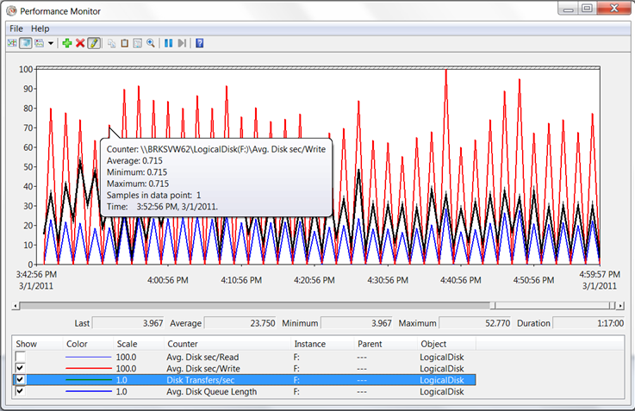
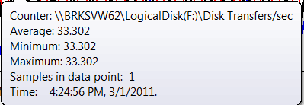
Troubleshooting Flow Example (continued)
Notice that we see 770 ms of write latency (blue arrow), yet
Only observe 30-50 disk transfers per second (green line)
Notes:
If you look at the green line as it crossed horizontally across the graph above (around the 30 line, which represents 30 disk transfers at a 1.0 scale), you will see that disk transfers/sec are very low. Since it is pretty inconceivable that a LUN from a SAN would only have the equivalent of a single hard drive assigned to it, this would suggest the issue is the HBA to the initial Public Fiber Adapter port on the SAN rather than a RAID group consisting of a single hard drive.

Slide 90
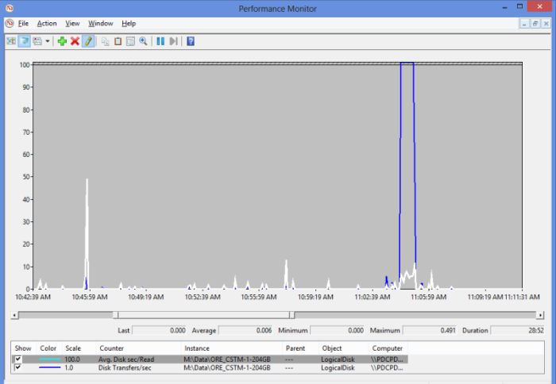
Challenge: Is This Disk or Fabric?
Notice that we observe
491 ms of read latency
with only 5 disk transfers
Later we observe 50 ms of
read latency with 280 disk
transfers
Notes:
In this example, we note very high latency for the mount point with very little disk activity. Later we note that there is much higher activity and much less latency. This may indicate that the mount point has a fabric or shared spindle bottleneck. Refer to the Troubleshooting Flow slide.

Slide 91
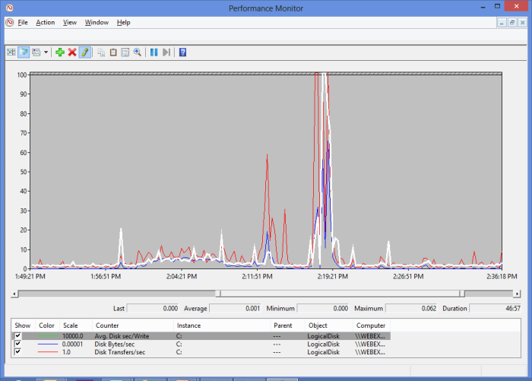
Challenge: Is This Disk or Fabric? (continued)
We observe that disk latency
increases only at times when
disk activity is higher
Notes:
In this example, we note latency for the disk. Disk latency is only an issue when disk transfers and disk bytes are higher. This may indicate that the LUN has a spindle bottleneck. There are not enough spindles to support the maximum load. Refer to the Troubleshooting Flow slide.

Slide 93
Knowledge Check
Do you suspect this is a JBOD or fabric issue?
How many spindles do I need to support this load under 15ms?
Notes:
Question 1 Answer:
At this point the issue is starting to look like it’s in the communication path (fabric) since the E:\ drive experiences high latency like the F:\ drive as soon as they put any small amount of I/O on the storage path. Remember, most HBA settings are defaulted to 32. These numbers represent a large I/O bottleneck when we see Avg. or Current Disk Queue Length go higher than the HBA queue depth setting.
Question 2 Answer:
If these are 15k spindles, you would only need at least 1 because the performance is so poor at 187 Disk transfers/sec and 11MB/sec from Disk bytes/sec, but since we are looking at over 1 second (1000 ms) of peak latency with frequent peaks to 500-800 ms this is suggestive initially of path over disk. The clue is that the E:\ drive is also impacted.

Slide 94
Process I/O Counters

Slide 95
Process I/O Counters
Process I/O operations
Avg. Disk Sec/Read or Write
Thresholds for Avg. Disk sec/Read or Write
Example of Avg. Disk sec/Write

Slide 96
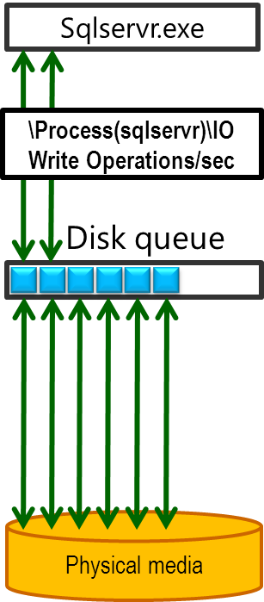
Process I/O Operations
\Process(*)\IO Read Operations/sec and \Process(*)\IO Write Operations/sec measure the rate at which the process is issuing read or write (respectively) I/O operations
This includes file, network, and device I/Os
Use as supplemental data of which process might be issuing disk I/O
Notes:
The \Process(*)\IO Read Operations/sec and \Process(*)\IO Write Operations/sec counters measure the rate at which a process is issuing read or write (respectively) I/O operations. This I/O can be file (disk), network, or device I/O. This counter does not differentiate the I/O resource type, so it is not a direct indicator of how a process is using disk I/O. These counters are best used to supplement data from other disk related performance counters.

Slide 97
Disk Free Space Counters
% Free Space measures the percentage of total usable space on a disk drive
Free Megabytes displays the amount of unallocated space on the disk
If the free disk space is low, defragmentation failures or failed writes can result. Also fragmentation is increasing
These counters are only part of the LogicalDisk counter object and do not measure free space for the LUN
If a disk is close to full, the Seek Time will be greater because the read/write heads generally travel more due to fragmentation
Notes:
When the capacity of a disk is full, it can cause many functional issues with the OS and disk performance might become slower as the disk fills up.
Use the % Free Space and Free Megabytes performance counters to determine whether the disk is nearing capacity.
These counters are part of the LogicalDisk counter object only. They are not part of the PhysicalDisk counter object. This is another reason to consider using LogicalDisk counter objects first.
Short stroking is a technique that was used prior to the wide spread availability of SSD. The technique allowed the administrator to configure the disk to only present the outer, faster portion of the disk. Disk free space may be usable to identify performance issues on a single disk (not virtualized storage).
Please note that ReFS will not work well with a nearly full disk as ReFS is “reserving space” and you might end up in a situation where you cannot create new files as all the remaining free space has been reservered.

Slide 98
Thresholds for % Free Space
Common next steps:
Delete or move any unneeded files
Increase disk capacity if you can
Threshold | Effect
10% or more | Informational Normal usage
Less than 10% | Warning Disk latency might occur
Less than 5% | Critical Disk latency is very likely. The system might not be able to write to the disk.
Notes:
Since disk performance and functionality of a disk might degrade as it fills up, monitoring disk free space is important. Therefore, as an initial indicator, monitor whether % Free Space is less than 10.
If it is, next look at the Free Megabytes counter to see exactly how much space is free. If the disk is nearly full, consider deleting unneeded files.

Slide 100
The Case of Slow Storage

Slide 101
IO IO Its Off To Disk I Go

Slide 102
Knowledge Check
True or false: IRPs in the disk queue are always served First In First Out (FIFO)
What is the general warning threshold for disk response times?
The response time thresholds are based on what I/O size?
How many IOPS would a RAID 5 disk array require to service a LUN generating 100 write operations per second?
What kind of I/O do the \Process(*)\IO Read Operations/sec and \Process(*)\IO Write Operations/sec counters measure?
Notes:
Question 1 Answer:
False: IRPs in the disk queue can be reorganized by the disk driver for speed and efficiency
Question 2 Answer:
The general warning threshold for disk response times is 15ms
Question 3 Answer:
The response time thresholds are based on an I/O size of 64 KB or smaller
Question 4 Answer:
It would require 400 IOPs to service 100 LUN write I/Os due to the RAID 5 write penalty of 4 operations per write I/O, since RAID 5 is (read)+(4 x writes)
Question 5 Answer:
The \Process(*)\IO Read Operations/sec and \Process(*)\IO Write Operations/sec counters measure disk, network, and device I/O

Slide 103
Microsoft

